Slide 1
Boat Racing 360 Computer Science Game - Final

Slide 2
Introduction

Slide 3
Initial Concept
“Boat Racing 360 is a game where the player picks a boat at the start, races against NPCs in a dangerous track with many hidden secrets, and collects points to unlock new boats.” - Boat Racing 360 Game Design Document

Slide 4
Initial Concept Acomplished?
Boat Race | Yes
Pick your boat | Yes
Races against NPCs | No
Dangerous Track with many Hidden Secrets | No
Boost & Boost Jump | Yes
Collect points & Unlock new Boats | No

Slide 5
New Concepts
Time Trial
Constant boost for certain amount of time
Sliding Boats
All different boats being available from the start (time/difficulty)

Slide 6
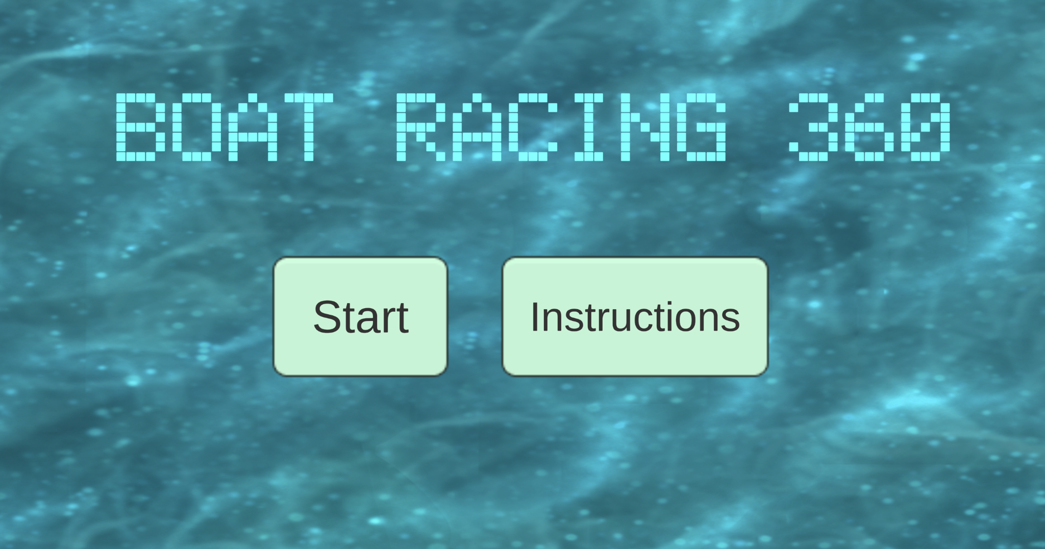

Slide 7
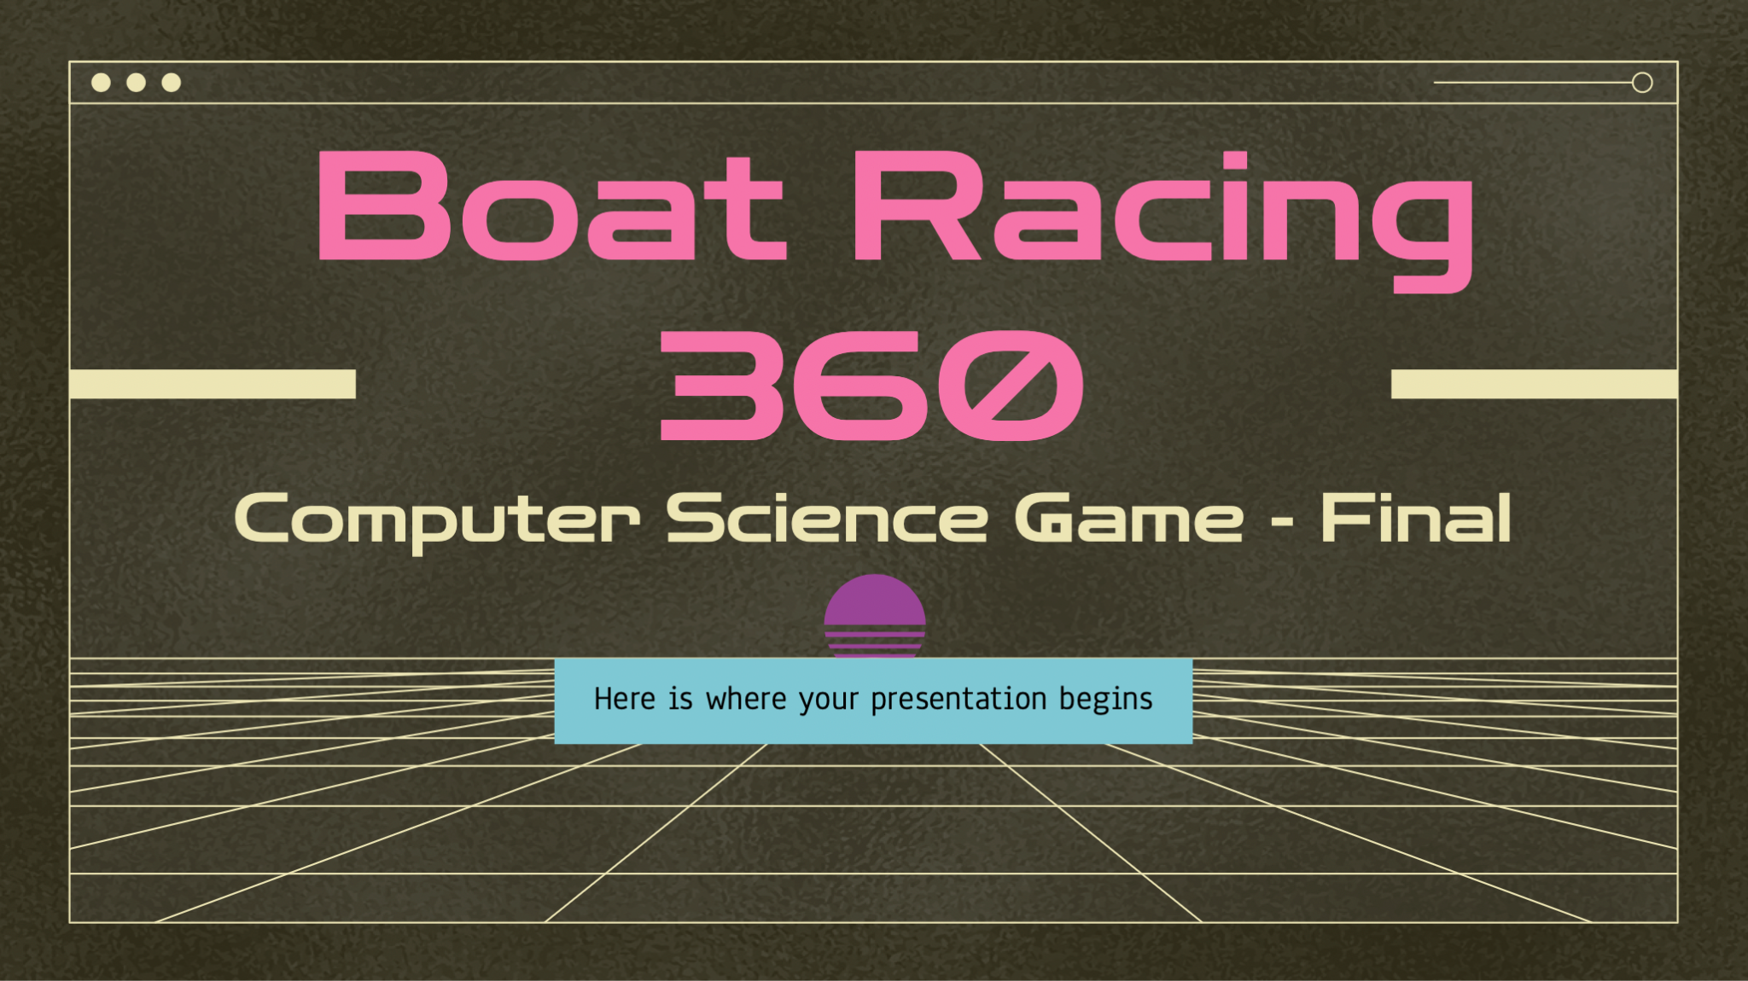
User Experience

Slide 9
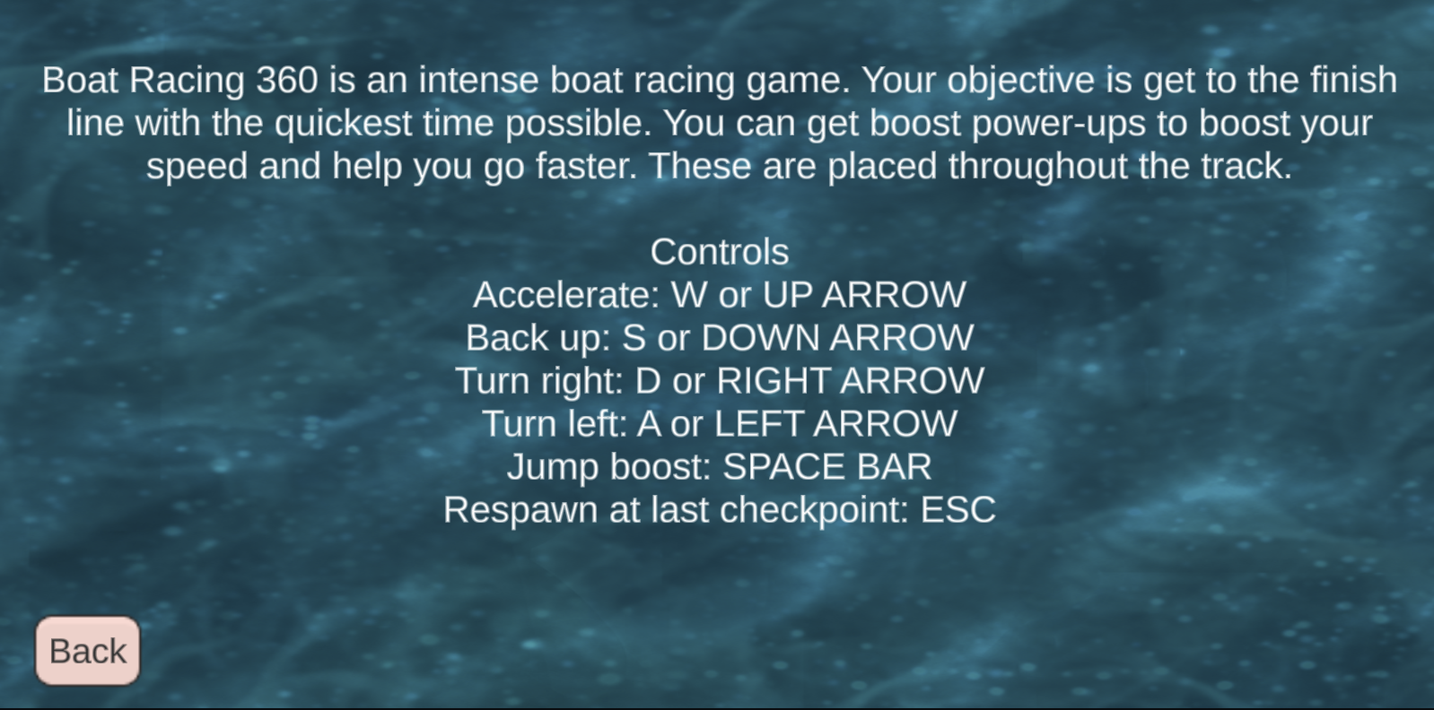

Slide 11



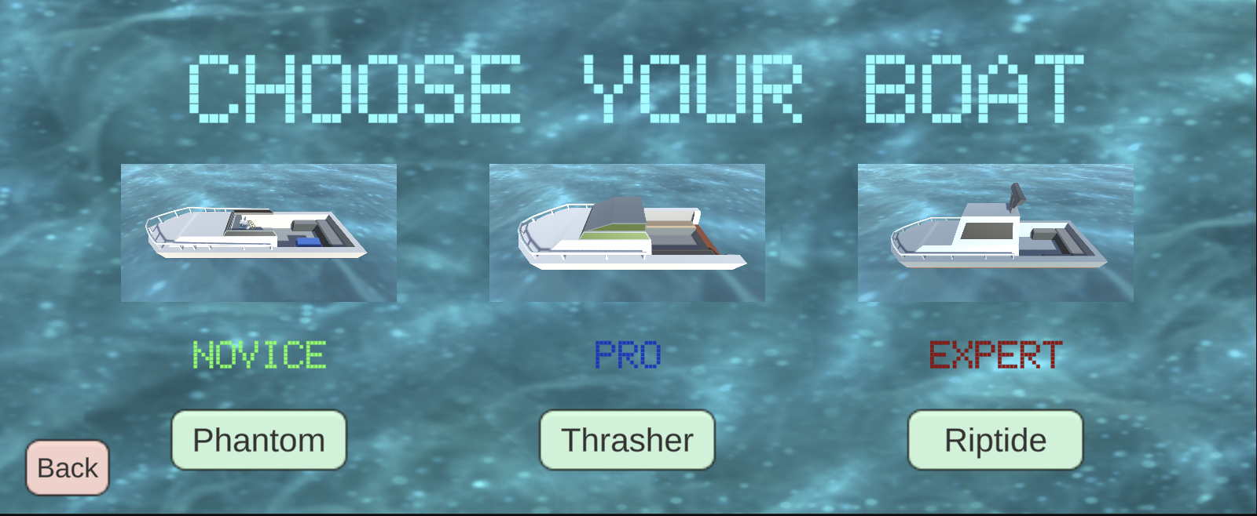

Slide 12
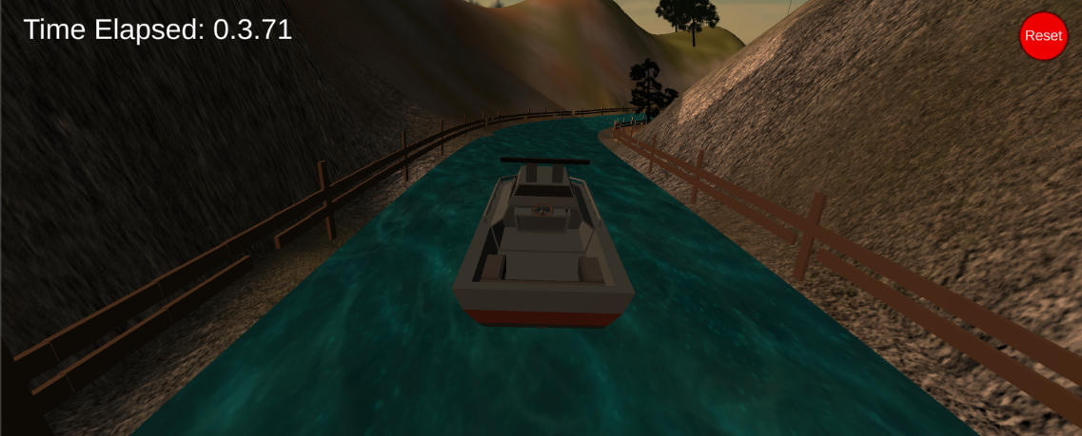

Slide 13
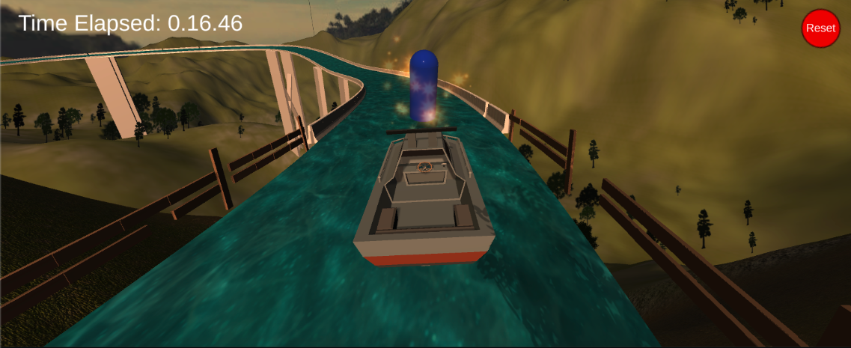

Slide 14
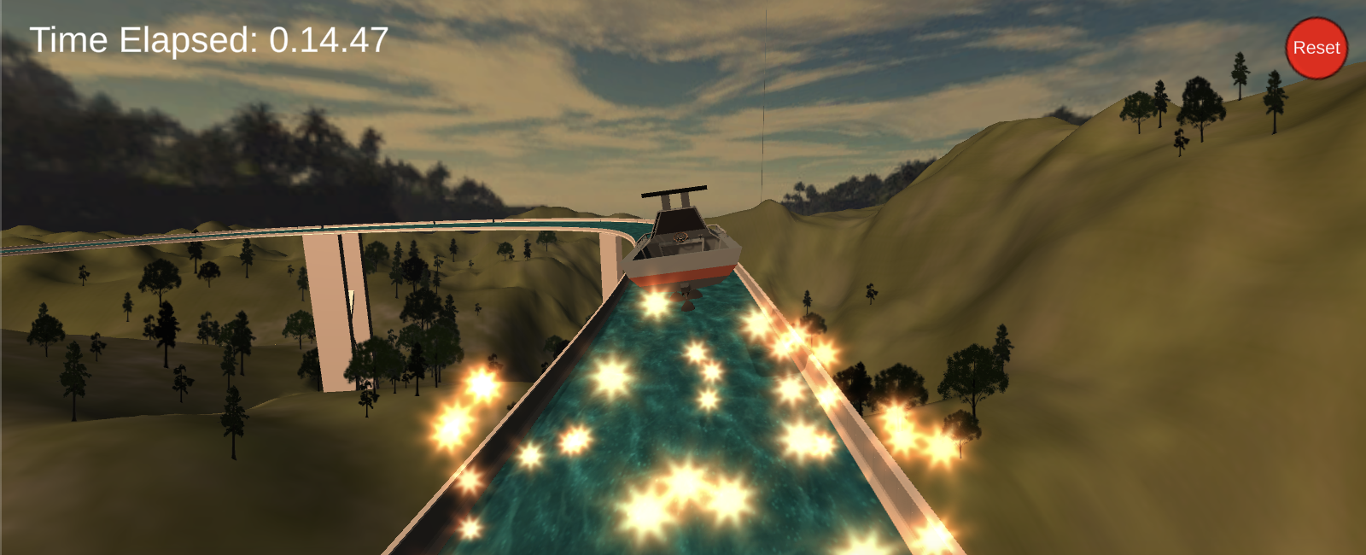

Slide 15
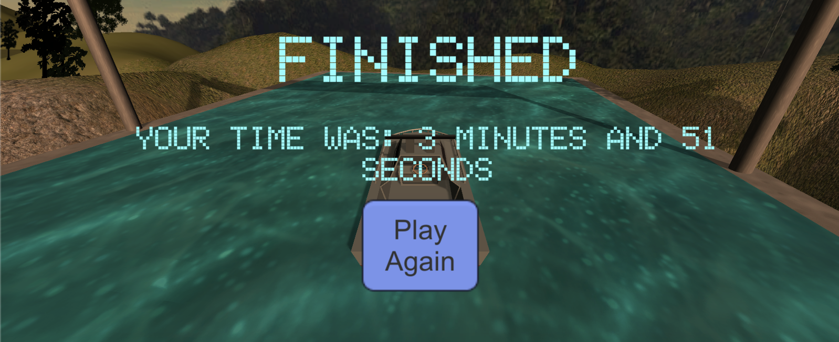

Slide 17
Scene

Slide 18
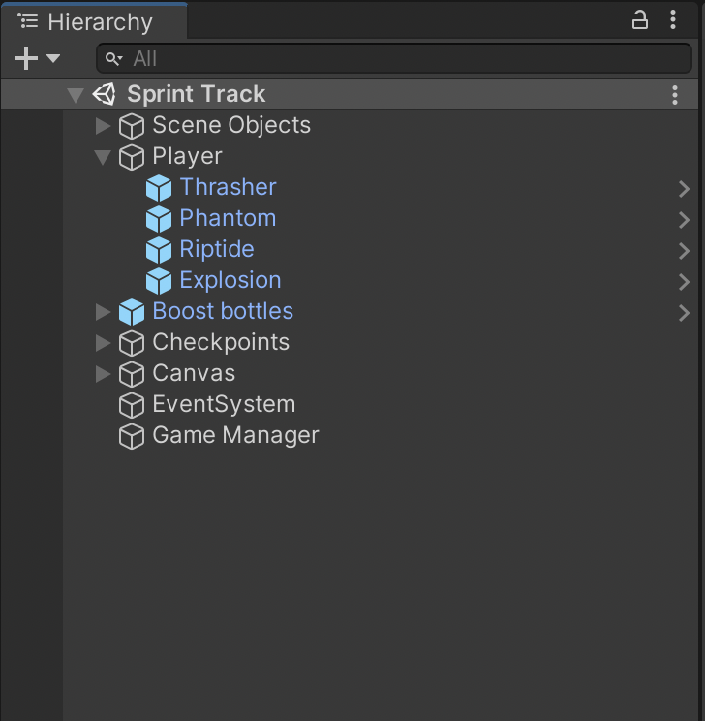

Slide 21
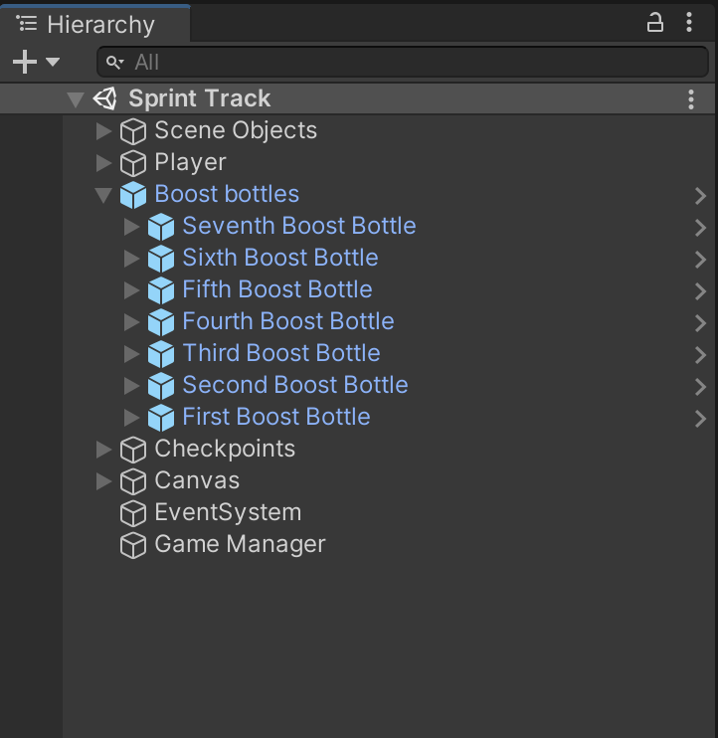

Slide 23
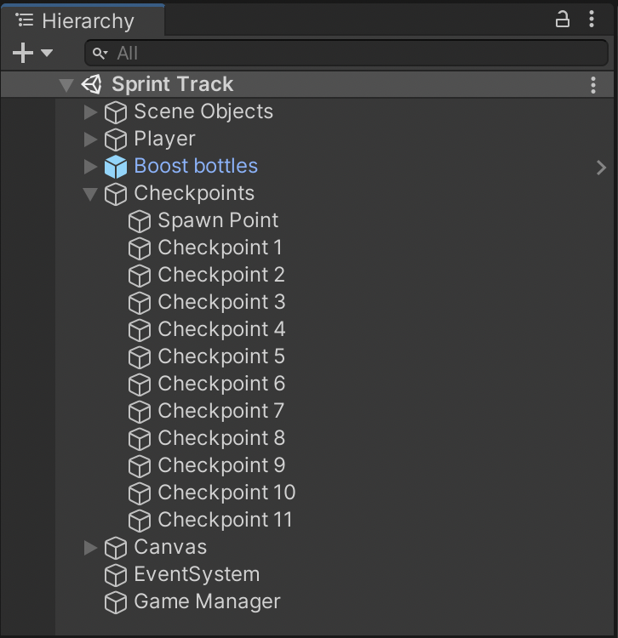

Slide 24
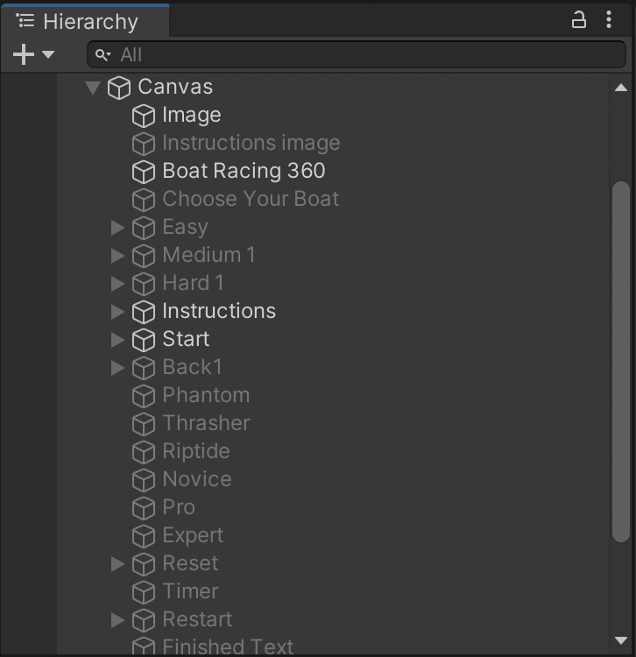
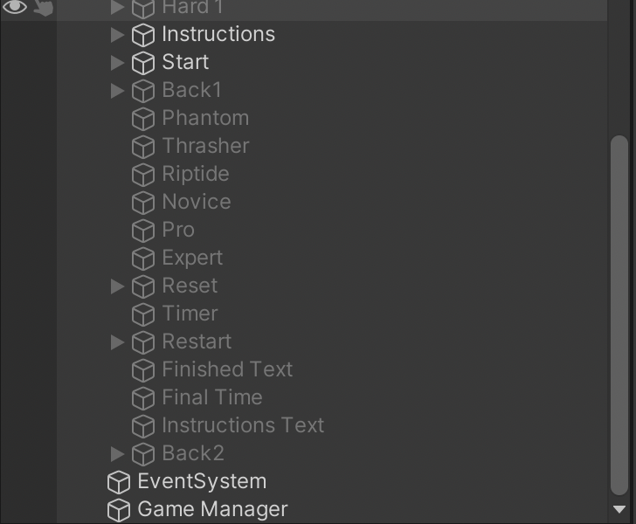

Slide 25
Scripts

Slide 26
Player Movement

Slide 27

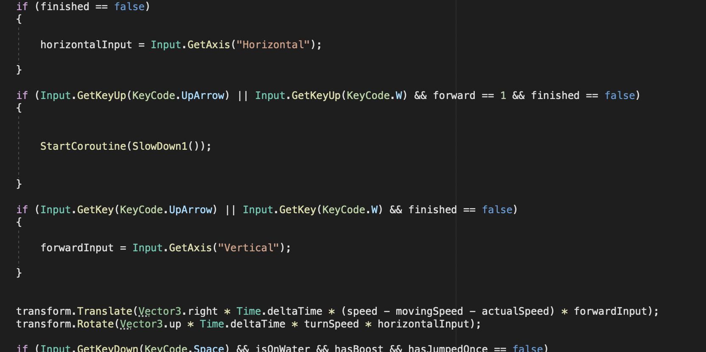

Slide 28
Differentiate Terrain & Water

Slide 29
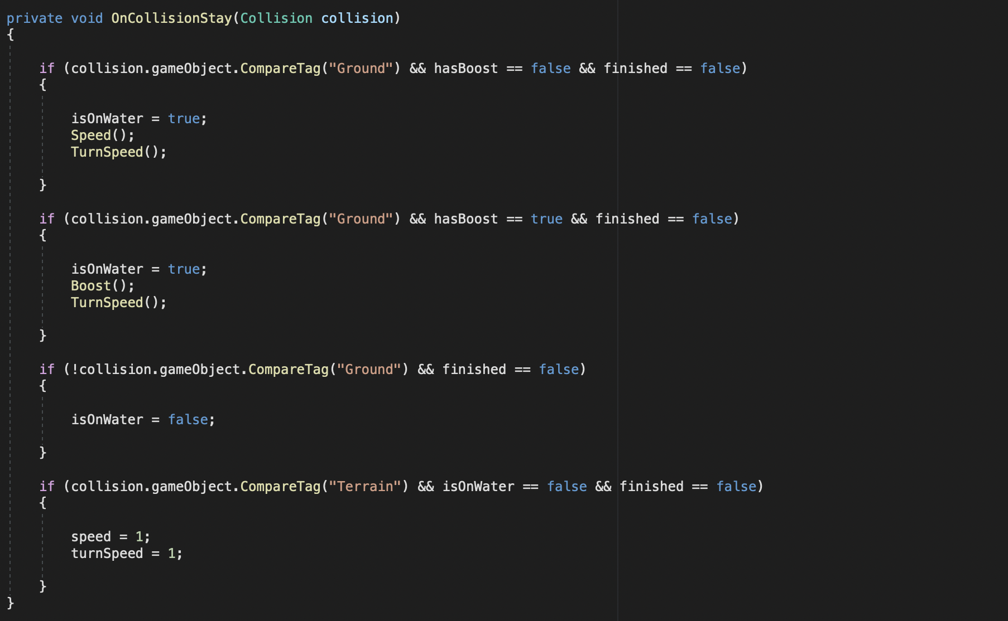

Slide 30
Keeping Time Neat

Slide 31
1.0.40
k

Slide 32
1.1031.40589
k

Slide 33
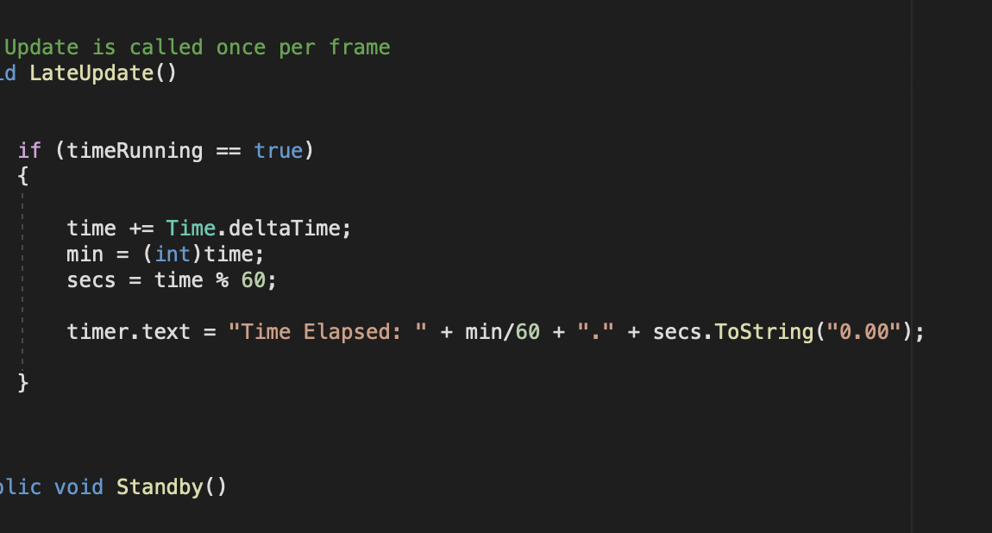

Slide 34
Challenge
Slowing Down Gradually

Slide 35
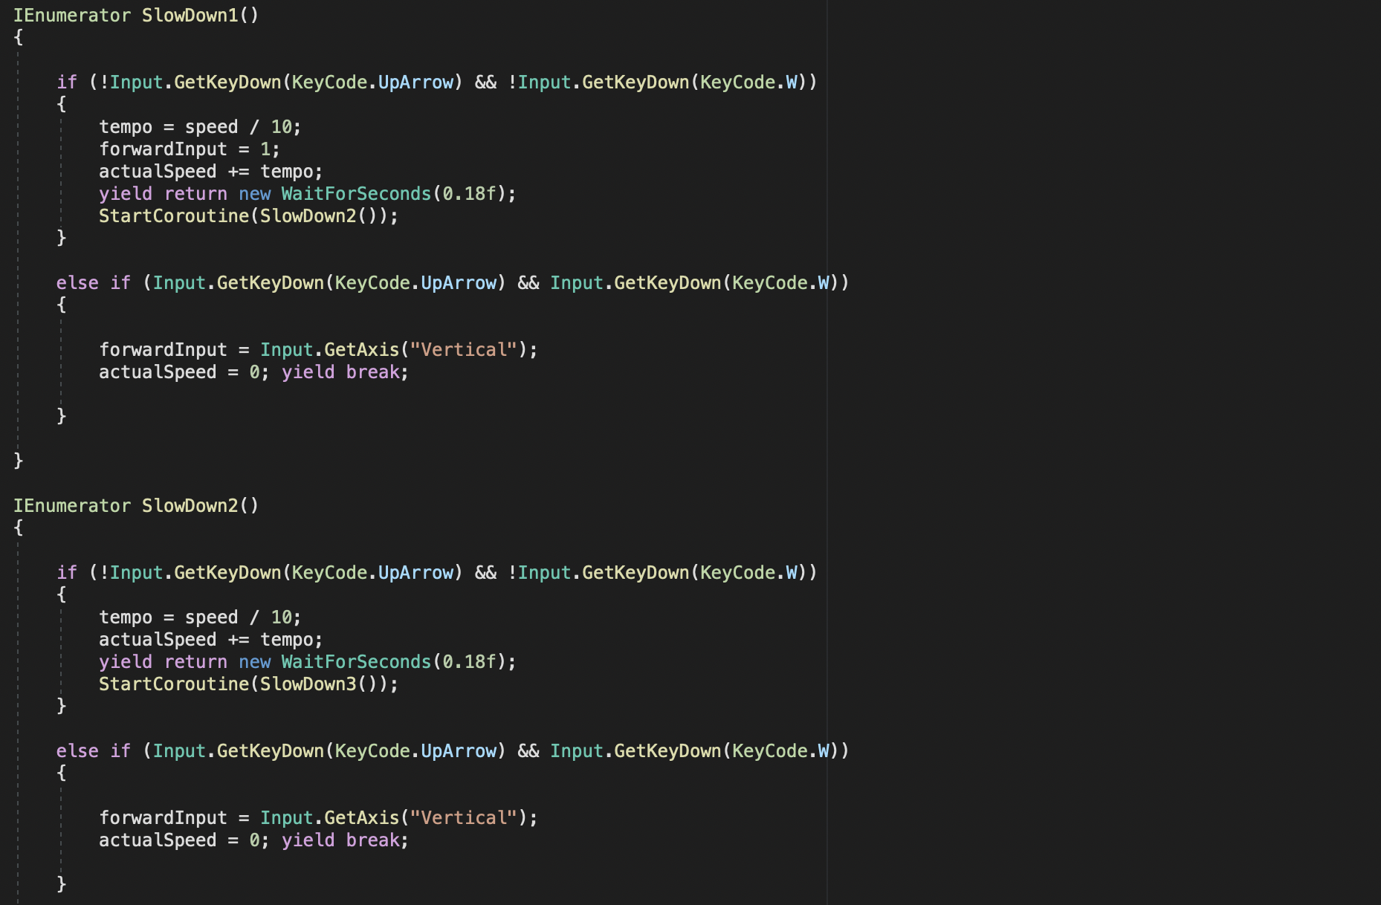

Slide 36
"Whether you think you can, or you think you can't… you're right.” - Henry Ford

Slide 37
Thanks for
the Semester

